Slide 1

Final Project
Idea pitch

Slide 2
Idea
4D Tetris:
similar to classic Tetris in its mechanics
BUT pieces are 4-dimensional collections of hypercubes projected into a 3D environment
for the prototype playtime is limited and highscore collected
Based on:
CM3030 Games Development Project Idea Title 1: Arcade Game

Slide 3
Motivation
Tetris is a staple of the video game industry. Still played today after more than 30 years
Very easy to understand but very hard to master
Extending it into 4-dimensional space increases the number of possibilties and reduces the ability to memorize/predict the outcome of rotation.
This increases complexity while capturing the classic addictive gameplay
I myself spent a lot of time playing a 3D port as a kid

Slide 4
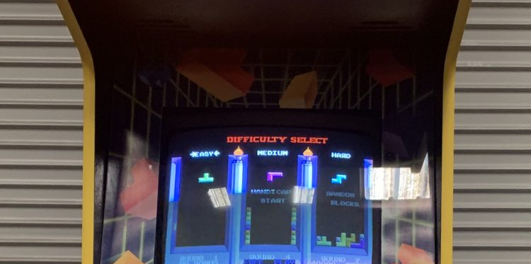
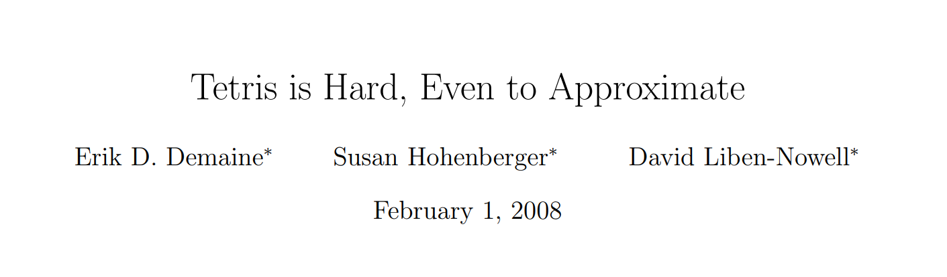
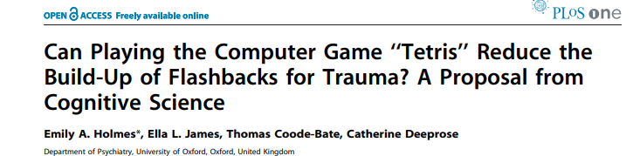
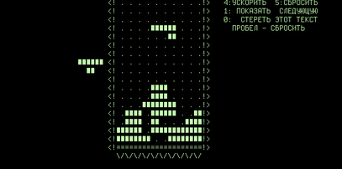
Tetris
invented by a mathematician
very addictive gameplay
very limited due to underlying architecture
redone multiple times (GameBoy)
sold around 500 million copies
Basis of a lot of research in computer science, design, ML, psychology and many more
Played to this day
Modern copies often diluted with new ‚features‘
Original unplayabale by modern standards
https://arxiv.org/abs/cs/0210020
Demaine, E.D., Hohenberger, S., Liben-Nowell, D. (2003). Tetris is Hard, Even to Approximate. In: Warnow, T., Zhu, B. (eds) Computing and Combinatorics. COCOON 2003. Lecture Notes in Computer Science, vol 2697. Springer, Berlin, Heidelberg. https://doi.org/10.1007/3-540-45071-8_36
Can Playing the Computer Game “Tetris” Reduce the Build-Up of Flashbacks for Trauma? A Proposal from Cognitive Science
Holmes EA, James EL, Coode-Bate T, Deeprose C (2009) Can Playing the Computer Game “Tetris” Reduce the Build-Up of Flashbacks for Trauma? A Proposal from Cognitive Science. PLOS ONE 4(1): e4153. https://doi.org/10.1371/journal.pone.0004153

Slide 5
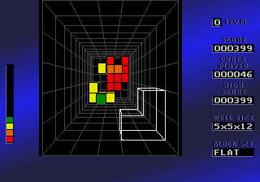
Block Out
1989 3D clone of Tetris
Adds complexity while keeping the gameplay
Addictive but hard to master
Little help for beginners, visualization lacking
Unable to copy the success of its 2d counterpart

Slide 6

Frac 4D
Tried implementing 4 dimensions
Spread over multiple gameboards
Never published
Complexity of gameplay too high
Interesting features, such as highlighting the position

Slide 7

4DTris
Also implements 4 dimensions
Different gameplay, as the individual pieces are placed within a 2x2x2x2 hypercube
Makes visualization very difficult
Never published
Good implementation of hypercube rotation

Slide 8
Pitch
Build 4D Tetris clone
Optics similar to BlockOut
Building on tested gameplay → Still beeing sold
Similar ideas have been tried but never succeeded (4DTris, Frac4D)
Building on these previous works we build a fun but complex game, that brings back the mathy feeling into Tetris, focus on teaching the player
Incorporate feature to help future scientific work (CSV export of input data…)

